Slide 1



PROJECT PROPOSAL
BY KEAGILE NDULI

Slide 2




INTRODUCTION
ORGANISATIONS
  Iron Crown Dentistry
  Mzansi Water Drilling

Slide 3
IRON CROWN DENTISTRY
ORGANISATION OVERVIEW
Iron Crown Dentistry is a dental practice that provides three main types of services:
  preventive dentistry
  restorative dentistry
  cosmetic dentistry.
The practice was founded in 2018 by Jon Snow.

Slide 4


MISSION
VISION
THE MISSION OF IRON CROWN DENTISTRY IS TO MAKE DENTISTRY AVAILABLE TO PEOPLE FROM UNDERDEVELOPED COMMUNITIES.
THE VISION IS TO BECOME A LEADING DENTISTRY WITH PRACTICES IN UNDERDEVELOPED COMMUNITIES.

Slide 5


TARGET AUDIENCE
  STUDENTS
  ELDERLY PEOPLE
  FAMILIES

Slide 6
WEBSITE GOALS
The main goals of the website are to improve the organisation's:
  Visibility online through SEO
  Make the information easy for users to understand
  Create a user-friendly experience that encourages new patients to book appointments.

Slide 7


  TRACK HOW MANY PATIENTS MAKE APPOINTMENTS AFTER VISITING WEBSITE
KEY PERFORMANCE INDICATORS
  MONITOR APPOINTMENT NO-SHOWS, HELPS THE ORGANISATION IDENTIFY WEAKNESS IN BUSINESS THAT WILL HELP THEM IMPROVE
  IDENTIFYING THE DENTISTRY'S BUSINESS COSTS, WHICH CAN HELP THE BUSINESS UNDERSTAND WHERE ITS MONEY IS BEING SPENT AND ALLOCATE ITS FUNDS MORE EFFECTIVELY.

Slide 8

PROPOSED FEATURES
  LANDING PAGE
  ABOUT US
  SERVICES PAGE
  TESTIMONIALS
  ONLINE APPOINTMENT BOOKING PAGE

Slide 9
DESIGN & USER EXPERIENCE
COLOR THEME:
Soft Green Tones For Calmness
TYPOGRAPHY
Raleway and Mulish
User Experience : Friendly and Simple

Slide 10
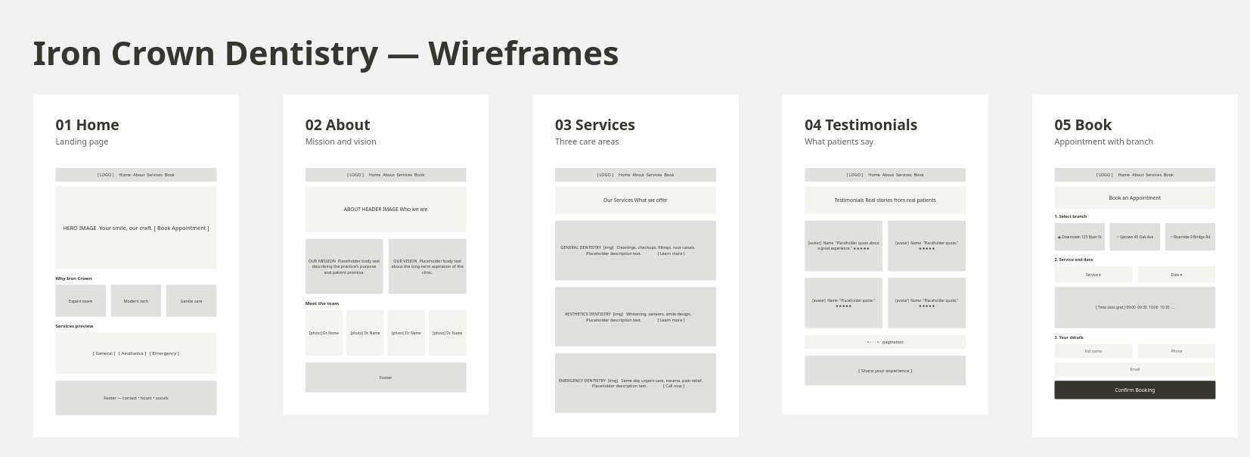
WIREFRAMES

Slide 11
TECHNOLOGY
FRONTEND:
  HTML
  CSS
  NODE.JS
  SQL
HOSTING & DOMAIN
  HOSTAFRICA
BACKEND:

Slide 12
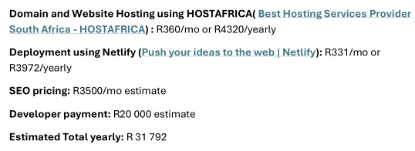
BUDGET

Slide 13




TIMELINES & MILESTONES
PHASE 1 (2 WEEKS)
PHASE 2 (4 WEEKS)
PHASE 3 (2 WEEK)
PHASE 3 (2 WEEK)
Planning and Research
Website Development Stage
Testing and Debugging Stage
Deployment Stage

Slide 14
MZANSI WATER DRILLING
ORGANISATION OVERVIEW
  Mzansi Water Drilling is a small business that provides borehole and water-drilling services.
  The business was founded by Tebogo Mohajane in 2020.

Slide 15
MISSION
VISION
THE MISSION OF MZANSI WATER DRILLING IS TO OFFER RELIABLE AND SUSTAINABLE WATER SOLUTIONS THAT IMPROVE ACCESS TO WATER FOR COMMUNITIES, HOMES AND BUSINESSES.
THE VISION IS TO EMPOWER COMMUNITIES THROUGH ACCESSIBLE, RELIABLE AND SUSTAINABLE WATER SOLUTIONS.

Slide 16
TARGET AUDIENCE
  HOMEOWNERS
  BUSINESS OWNERS
  GOVERNMENT SCHOOLS
  MALLS
  GOVERNMENT OWNED PROPERTIES

Slide 17
WEBSITE GOALS
The main goals of the Mzansi Water Drilling website are:
  Improve visibility online through SEO
  Make communication with customers easier
  Clearly display the services offered and increase website traffic.

Slide 18
KEY PERFORMANCE INDICATORS
  HAVING A CONSISTENT NUMBER OF MONTHLY WEBSITE VISITORS
  INCREASING THE NUMBER OF QUOTE REQUESTS
  RESPONDING TO CUSTOMERS WITHIN 24 HOURS
  MONITORING HOW MANY PEOPLE VISIT THE SERVICE PAGES.

Slide 19
PROPOSED FEATURES
  LANDING PAGE
  SERVICES
  PORTFOLIO
  FAQS
  CONTACT/ENQUIRE
  CREDIBILITY
  WHATSAPP COMMUNICATION

Slide 20
DESIGN & USER EXPERIENCE
COLOR THEME:
Dark blue and white
TYPOGRAPHY
Barlow Condensed and Manrope
User Experience : Friendly and Simple

Slide 21
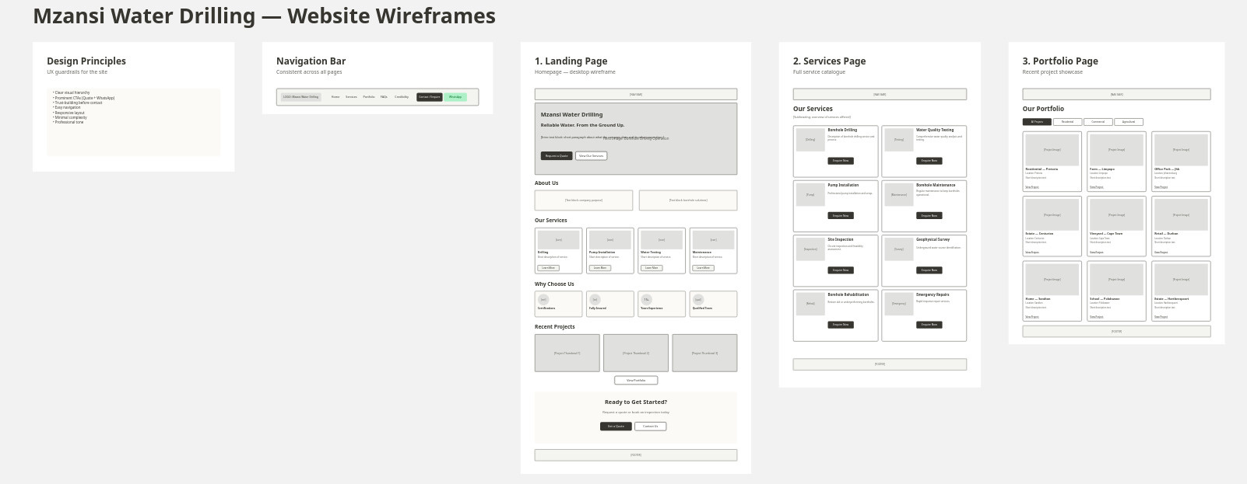
WIREFRAMES

Slide 22
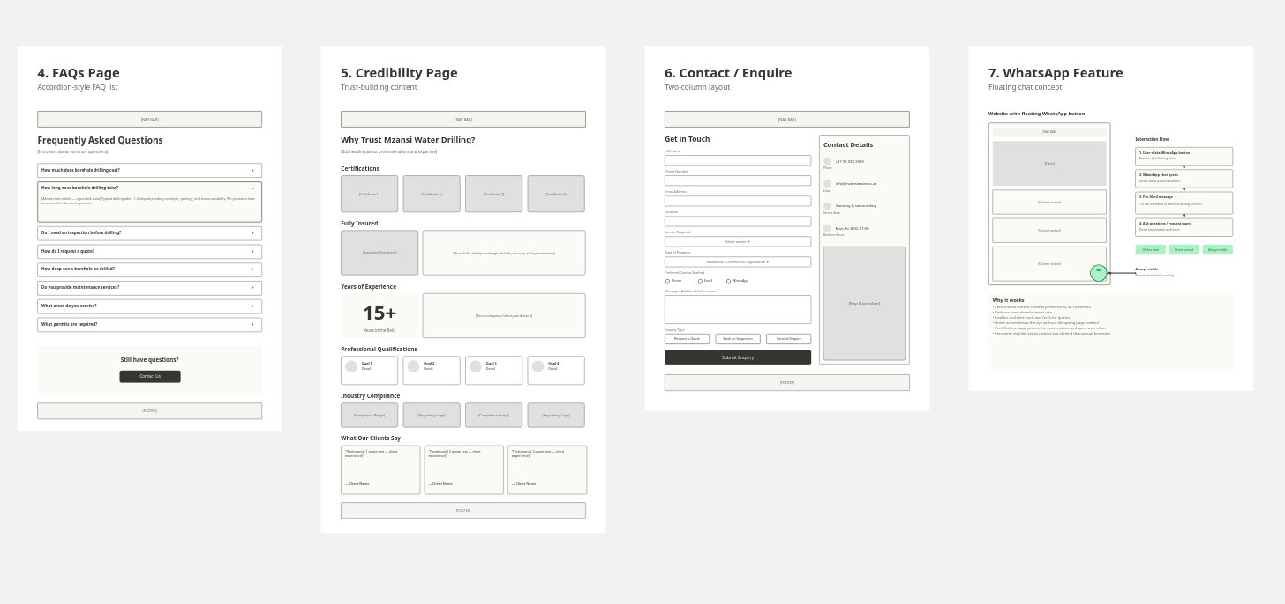
WIREFRAMES

Slide 23
TECHNOLOGY
FRONTEND:
  HTML
  CSS
  NODE.JS
  SQLite3
HOSTING & DOMAIN
  GoDaddy
  Netlify
BACKEND:

Slide 24
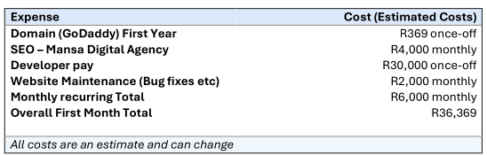
BUDGET

Slide 25
TIMELINES & MILESTONES
PHASE 1 (2 WEEKS)
PHASE 2 (4 WEEKS)
PHASE 3 (2 WEEK)
PHASE 3 (1 WEEK)
Planning and Research
Website Development Stage
Testing and Debugging Stage
Deployment Stage

Slide 26



QUESTIONS?

